Slide 1


Business Impact Presentation 4/13/2015 Steve Corndell

Slide 2

Agenda:
About VMTurbo
JM Smuckers Key Requirements
POV Overview
ROI Presentation
Proposal Discussion
Advanced Planning, Custom Dashboards, and Reporting

Slide 3









VMTURBO Background
Trusted by 1,000+ Enterprise Customers
In 1 hour, VMTurbo will solve the most complex problem in virtualization today:
Assure Application Performance while maximizing the underlying infrastructure
Founded in 2009
A better way to manage IT operations…

Slide 4
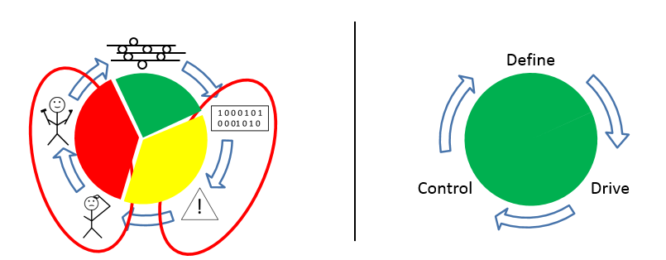
Rethinking the approach
Traditional methods wait until you have a problem, send you an alert and allow you to troubleshoot and fire fight AFTER you have a problem
Virtualization enabled us to prevent problems from happening. VMTurbo gives us the recommendations to make sure you do not leave an optimal state

Slide 5
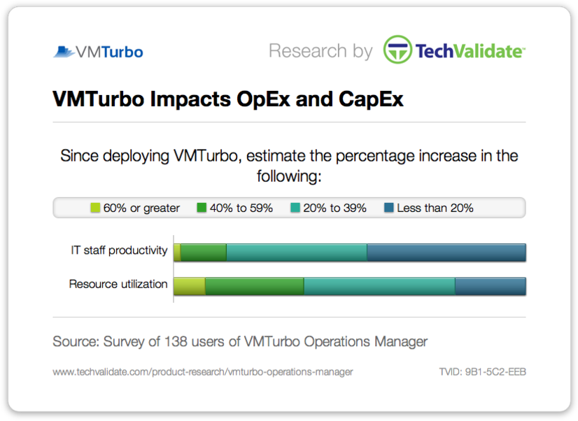
VMTurbo Improves CAPEX and OPEX
55% of customers increased IT staff productivity by 20% or more since deploying VMTurbo
VMTurbo Impacts CapEx
VMTurbo Impacts OpEx
: 9%
: 28%
: 43%
: 20%
: 2%
: 13%
: 40%
: 45%
80% of customers increased resource utilization by 20% or more since deploying VMTurbo

Slide 6
Agenda:
About VMTurbo
JM Smucker’s Key Requirements
POV Overview
ROI Presentation
Proposal Discussion
Advanced Planning, Custom Dashboards, and Reporting

Slide 7
Requirements:
Assure Application Performance
Ability to automate preventive tasks to keep environment healthy, by providing executable actions instead of just alerting when a problem happens.
Understands when to add compute or capacity to environment.
Must be able to make rightsizing recommendations simultaneously with placement and capacity with justification as to why a VM needs to be sized differently.
Improve Efficiency
Ability to make rightsizing recommendations simultaneously with placement and capacity: by doing this we must demonstrate how to safely increase VM Density.
Can create on demand reports with justification behind the recommendations and show resource peaks and averages.
Ability to converge the peak resource utilization of hosts with averages to allow an increase in VM density without impacting application performance to end users.
Tying Capacity planning with real time actions
Ability to simulate adding or removing any resource (VM’s, datastores, & hosts) to accommodate planned growth and make better decisions about hardware requirements.
Ability to increase VM count: adding VM’s into clusters and accurately forecast when additional hardware is needed to support VM’s.
Must be able to provide detailed reporting of plans with the decisions as to where to place the virtual machines across the infrastructure to show how to execute plan.
Future Proof and Operationalizing the Platform
Must be able to quickly and easily provide insight into the health and risks across the virtual infrastructure.
Ability to provide specific recommendations to reduce the present risks and provide preventative recommendations to prevent future problems from impacting VM performance.
Provide high level dashboards of the status of the entire environment: easily customizable and must be able to provide on demand reports based on the custom dashboards.

Slide 8
Agenda:
About VMTurbo
JM Smucker’s Key Requirements
POV Overview
ROI Presentation
Proposal Discussion
Advanced Planning, Custom Dashboards, and Reporting

Slide 9
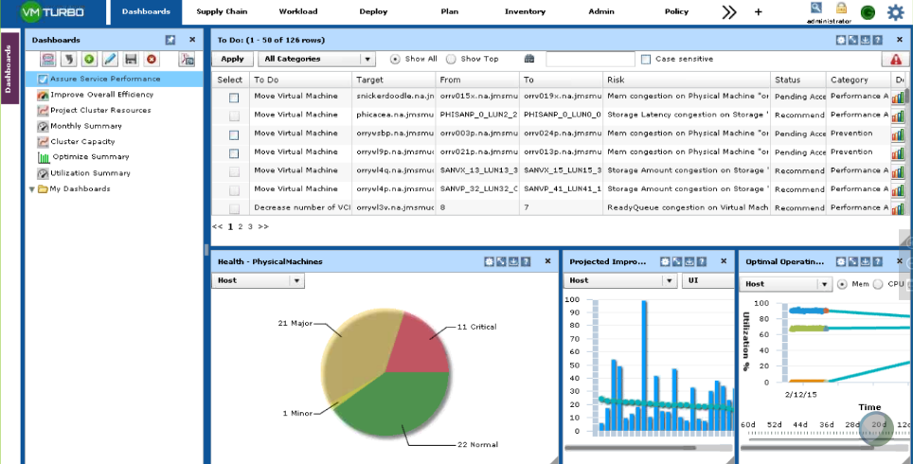
Testing VMTurbo: Assuring Application Performance
Within 15 minutes of installation, VMTurbo identified and prescribed actions to remediate 126 outstanding performance issues within the virtual infrastructure
Once VMTurbo has improved the performance, it will continue to make optimization recommendations to prevent issues from reoccurring.
During the POV, VMTurbo identified several actions that can be applied (manually or in automate) to move the environment into a healthy state. Both placement & sizing recommendations simultaneously with an understanding of capacity.

Slide 10
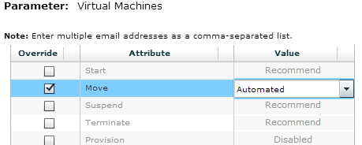
Testing VMTurbo: Assure Application Performance
JM Smucker has the ability to choose various actions around Keeping the environment healthy:
Automate: will keep the environment healthy, automatically apply the recommendation as soon as VMTurbo determines a change
Manual: ability to click the recommendations and hit apply
Recommend: read recommendations to keep environment healthy
Schedule: ability to schedule changes during maintenance windows.
Recommendations around:
vMotion
Storage vMotion
Resize
Control Options:
All VMs
By Cluster
By Network
By Storage
By Folders
By individual groups that JM Smucker can create

Slide 11
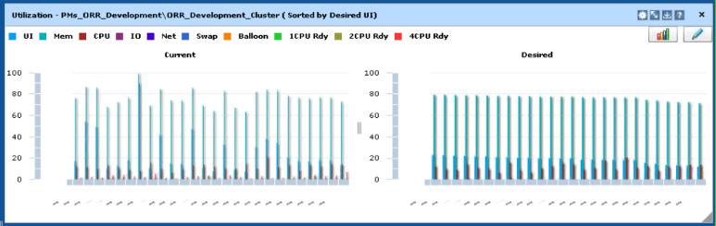
VMTurbo: Assuring Application Performance
Balloon & CPU Ready Time across every host
Once all of the actions are taken at the bottom and you are at the state on the right, VMTurbo will keep you there perpetually, assuring performance while maximizing the efficiency of the hardware.
Performance Risks (145 VMs at performance risk in ORR Cluster)
Inefficiency
VMTurbo Analysis shows 316 actions to move ORR Cluster to healthy state (502 actions total across environment during simulation at VMTurbo’s Lab)

Slide 12
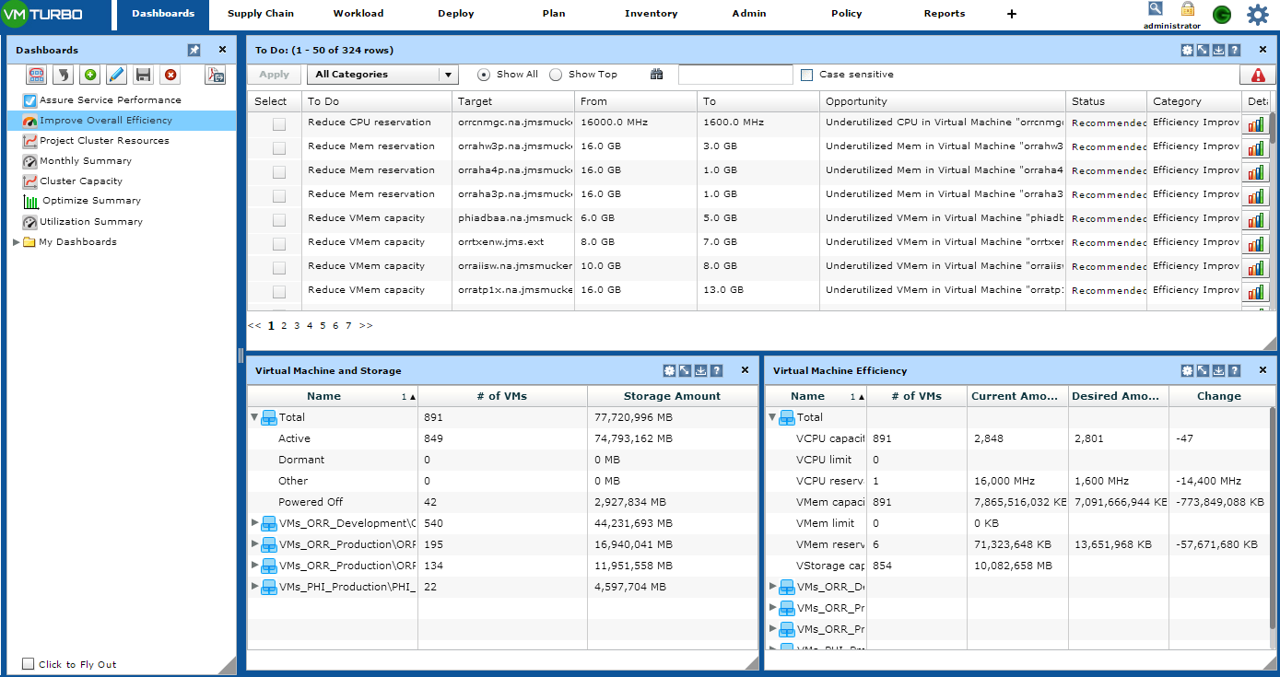
Testing VMTurbo: Maximize Infrastructure Efficiency
VMTurbo identified 324 opportunities to reduce allocated or reserved resources.
Reclamation will enable J.M. Smucker to drive greater VM:Host densities, improving the TCO of the virtual infrastructure

Slide 13
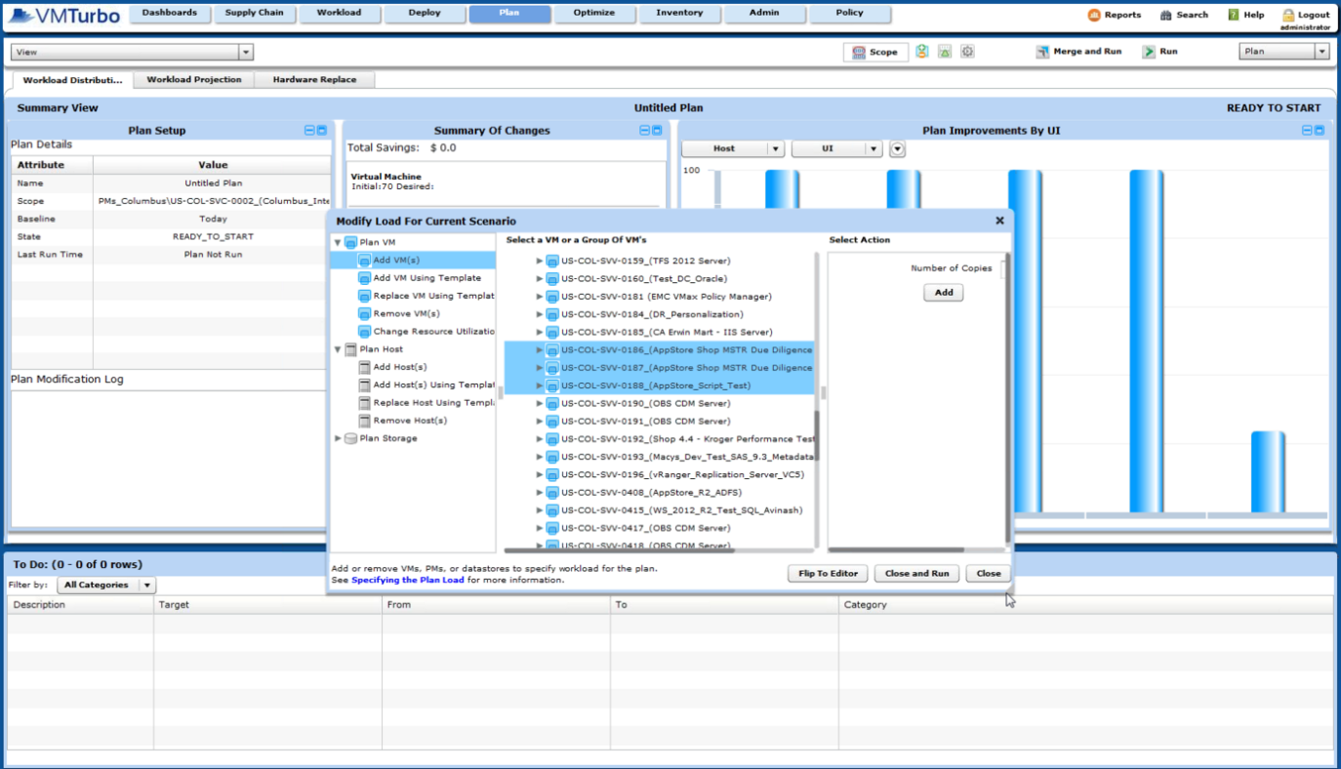
Testing VMTurbo: Capacity Planning
How much infrastructure is necessary to guarantee QoS if 29 workloads are ADDED to the ORR_Development cluster?
VMTurbo will enable J.M. Smucker to efficiently plan and manage the entire lifecycle of VMs and infrastructure

Slide 14
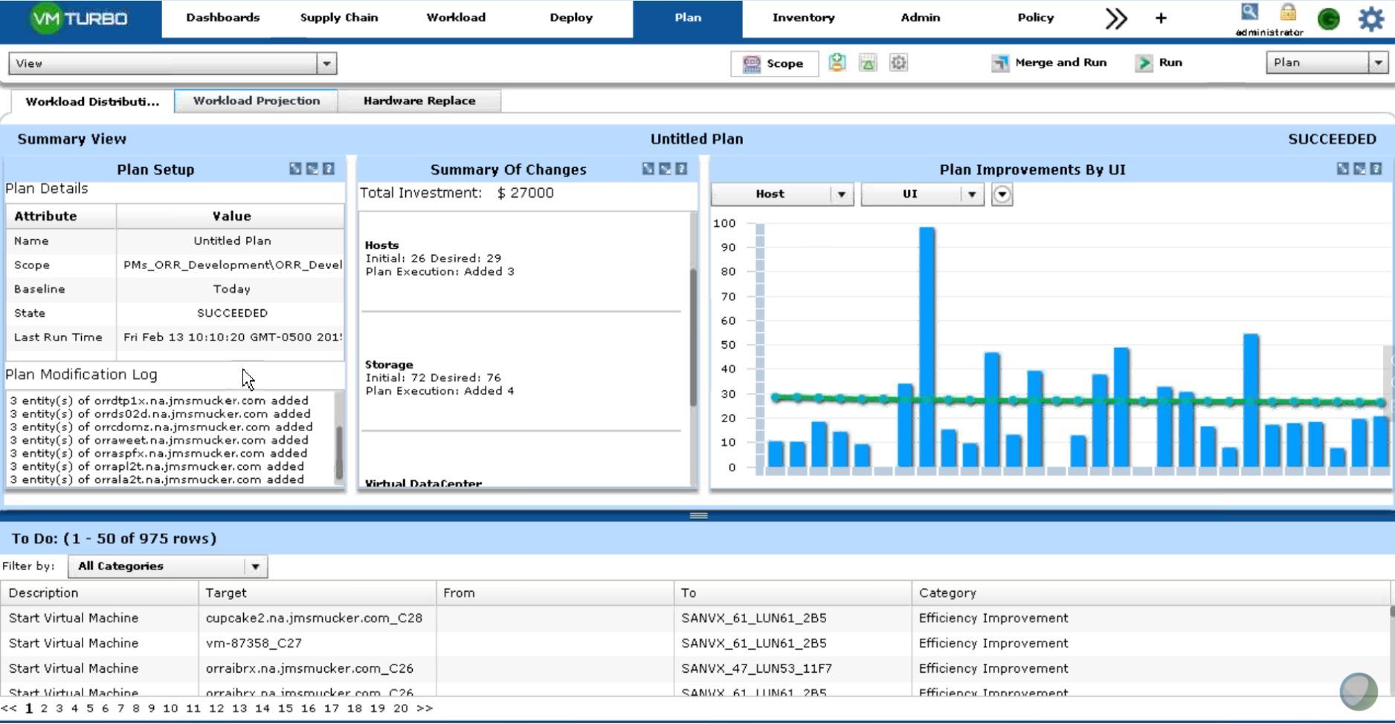
Testing VMTurbo: Capacity Planning
VMTurbo proved in order for J.M. Smucker to successfully add the additional 29 workloads to the Orr_Development environment you would need to purchase 3 hosts to have high QOS.
This allows J.M. Smucker to quantitatively ensure a successful workloads are place and sized appropriately across the infrastructure

Slide 15
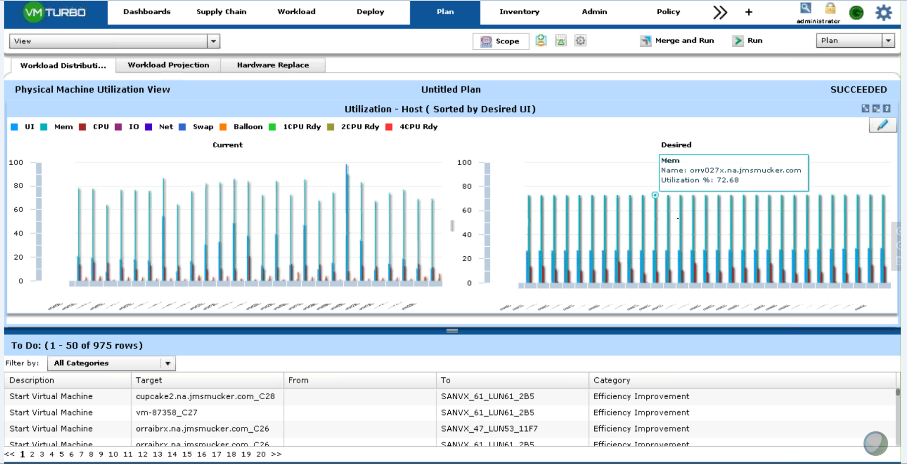
Testing VMTurbo: Capacity Planning
VMTurbo will show JM Smucker the before and after state of the cluster regardless of any type of simulated change.

Slide 16
Agenda:
About VMTurbo
JM Smucker’s Key Requirements
POV Overview
ROI Presentation
Proposal Discussion
Advanced Planning, Custom Dashboards, and Reporting

Slide 17
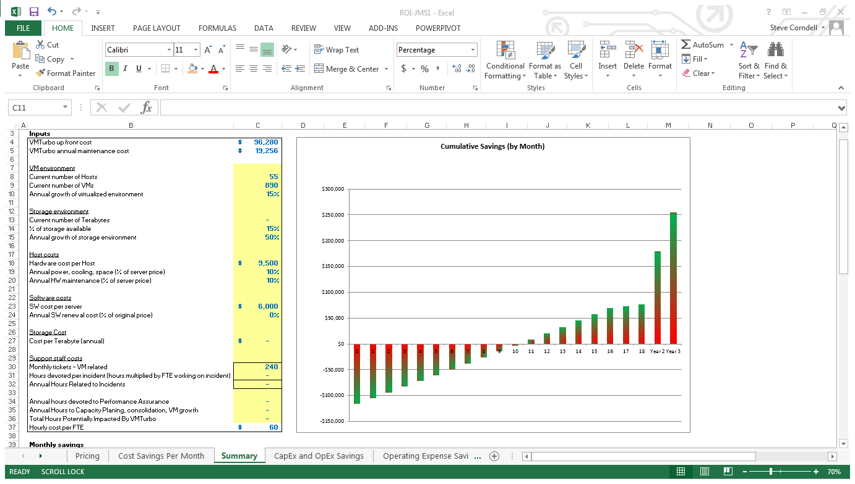
Return on Investment Summary
Projected payback period of 9 months… @20% increase in VM Density.
Plan on purchasing 8 ESX hosts for growth: 17 VMs per host = 136 more VMs, or 15% growth.
80% reduction in time managing environment (20 hours per month)

Slide 18
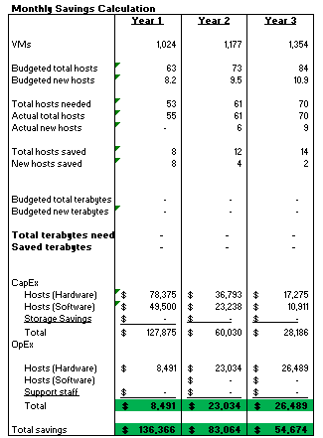
Return on Investment Summary
ROI Key Assumptions…20% increase in VM Density drives 14 less host purchases over 3 years.. $275,000

Slide 19
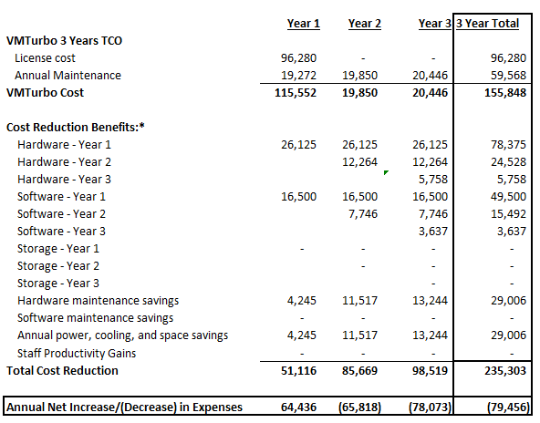
Return on Investment Summary
On a P&L basis…

Slide 20
Agenda:
About VMTurbo
JM Smucker Key Requirements
POV Overview
ROI Presentation
Proposal Discussion
Advanced planning and custom dashboard tutorial

Slide 21
Operationalizing VMTurbo – the Plan
RAPID SUCCESS ENGAGEMENT:
JM Smucker has worked with VMTurbo to quickly Operationalize VMTurbo:
VMTurbo license key enabled (platform is already installed, minimal time needed to upgrade to new version, add additional vCenters, and license key).
Discussed Requirements with VMTurbo Rapid Success Team.
Value Plan created:
Harmony
VM Move Actions Automated / Manually applied
Plan: Model with constraints, higher host utilization, reduce future spend / increase VM Headroom
Storage: equalize latency and IOPs
VM Right sizing's: understand the opportunity to release committed resources
Liquidity:
Examine Constraints – cluster boundaries
Plan: model without constraints
Utilization model vs. Static Tiering
Demand Drive Automated Control
Adaptive control in response to varying demand
Integrated with provisioning for intelligent initial placement
Spanning Technologies and vendor agnostic approach
New technology adoption and value

Slide 22
Operationalizing VMTurbo – the Plan
4. VMTurbo Value Milestone & Run Book creation:
1. Document initial state of JM Smucker
2. Detailed Rapid Success Recommendation and Summary report with milestones and measurable outcomes
5. Rapid Success Engagement includes:
1. Two days of on-site advanced training providing both lab and hands on instruction with a certified VMTurbo Trainer
2. Two days of consultative services from a VMTurbo Customer Success Manager to understand the use-cases outlined, people, processes and integration points and provide guidance and knowledge transfer
3. Review more complex use cases and document how to leverage VMTurbo for solving these problems
4. Provide detailed information on how VMTurbo can integrate with any relevant 3rd party solutions. 5. Additional ½ day of training where all knowledge transfer activities will be reviewed, documents will be distributed, and any topics still unaddressed will be covered.

Slide 23
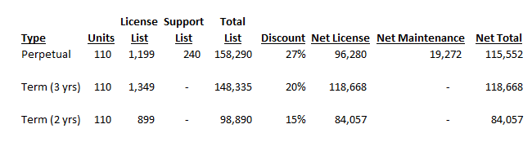
Pricing
Rapid Success Engagement: $12,500
$128,052 includes perpetual license & RSE

Slide 24
Agenda:
About VMTurbo
JM Smucker Key Requirements
POV Overview
ROI Presentation
Proposal Discussion
Advanced planning and custom dashboard tutorial

Slide 25
Advanced Planning, Custom Dashboards, and Reporting

Slide 26
Advanced Planning, reporting, and dashboards
Current dashboard views that come with VMTurbo
Edit standard dashboard views
Create a dashboard from scratch
Planning
Advanced planning
Planning Settings

Slide 27
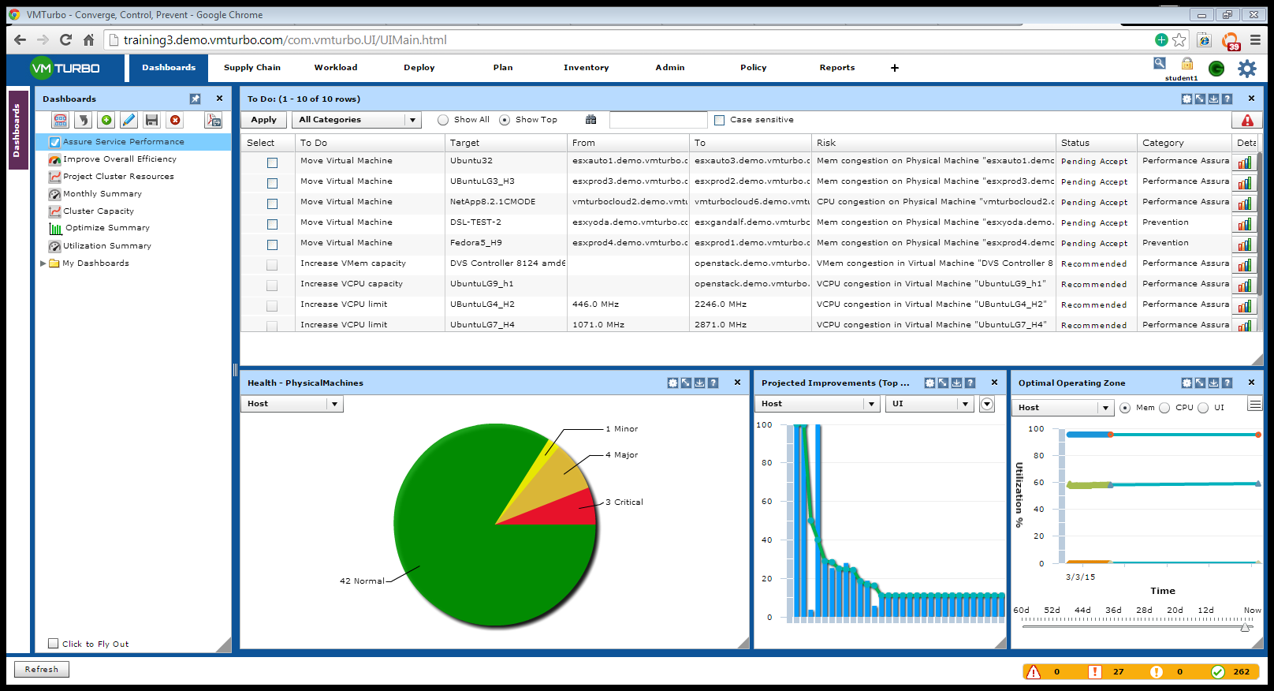
Custom Dashboards
1.
Dashboard tab: This will allow JM Smucker to see specific view to manage performance, capacity, and efficiency of the environment.
The default view shows the Assure Service Performance view of all VMs, Hosts, and Clusters plugged into VMTurbo.
To Do List: placement, sizing, and capacity actions to take to move environment to best possible state
2.
3.

Slide 28
Custom Dashboards understanding how to navigate specific views
Scope button: Once you click this button you can define the specific cluster that you want to view.
Back button: If you scoped to a specific cluster, you can hit this button to reset the view (meaning it will go back to entire environment)
Create a custom dashboard from scratch
Edit one of the dashboards you created or one of the views that come standard
Save the current dashboard that you created. This will appear in the “My Dashboards” folder
Delete a saved dashboard from the “my dashboard” folder
If you want to generate a report of the custom dash board, scope the data exactly the way you want to see it (i.e., 7 days of memory trend). You can then generate on demand PDF/EXCEL, or Save the report (this is helpful to schedule the report to send to someone)

Slide 29
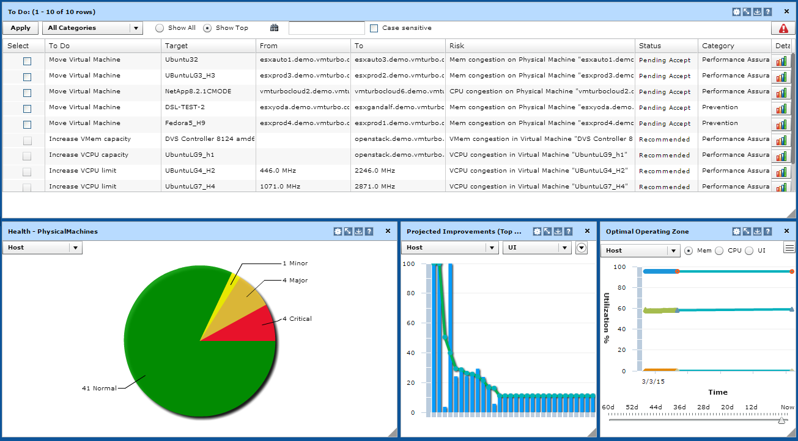
Custom Dashboards understanding how to navigate specific views
This screen shows all of performance and prevention actions to take to move JM Smucker to the most resilient state (automate to keep it there!) It can be scoped to a cluster by selecting the scope button.

Slide 30
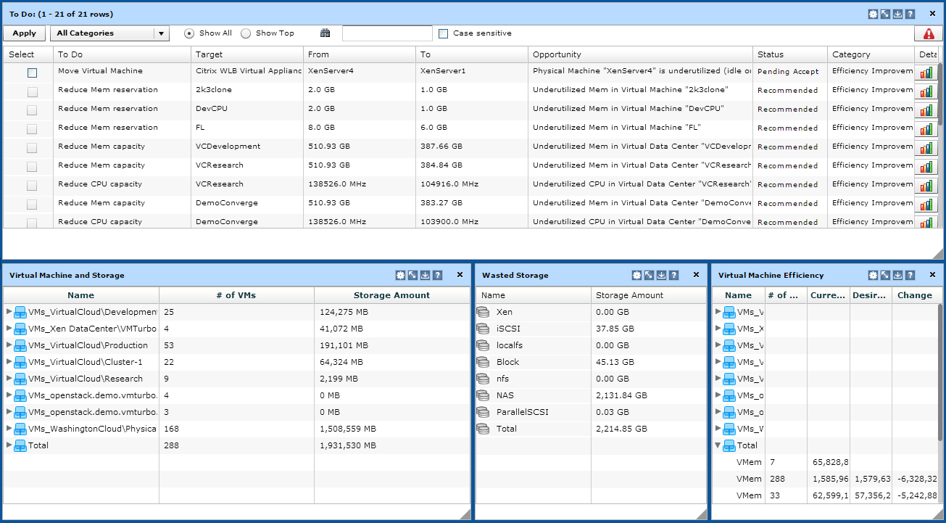
Custom Dashboards understanding how to navigate specific views
This screen shows all of the over allocations of resources in the environment. It can be scoped to a cluster by selecting the scope button.

Slide 31
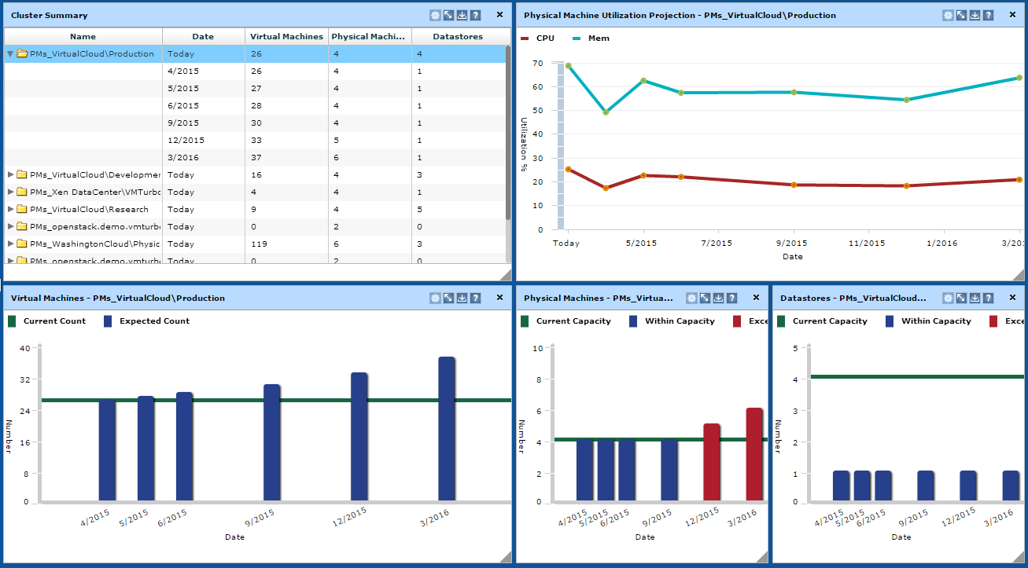
Custom Dashboards understanding how to navigate specific views
This will show how each cluster will be changing based on a monthly basis. It will project #of VMs, Hosts, and Datastores JM Smucker will need based off of the trending of resources.

Slide 32
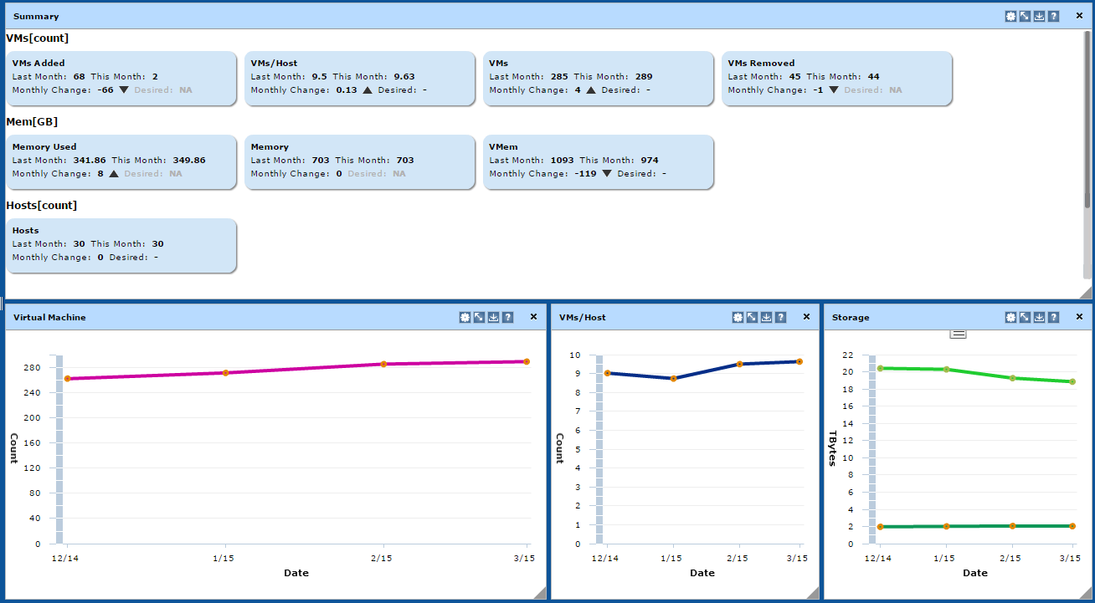
Custom Dashboards understanding how to navigate specific views
This screen will show how JM Smucker’s environment has been changing on a monthly basis. It will break down VM changes (added, VMs/Host, total VMs, VMs Removed. It will also break down Memory, Hosts, and Storage changes.
Note: if you want to see 1 particular cluster SCOPE it down by selecting the scope button.

Slide 33
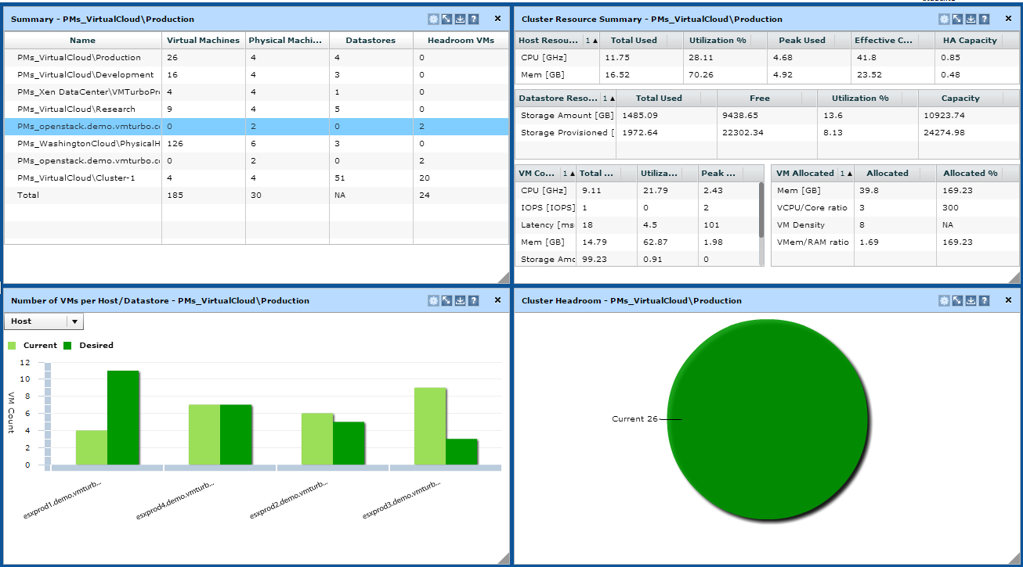
Custom Dashboards understanding how to navigate specific views
Cluster Capacity: top left is a summary of “How Many More VMs” can I safely add (based off of a template). To edit the template size go to the POLICY (tab at the top), then drop down the CLUSTER CAPACITY tab, then HOST, then pick the cluster, change the template size.
The right size shows the Cluster Resource summary: CPU, Memory (total used, %, Peak, Effective capacity, and HA capacity)

Slide 34
Custom Dashboards understanding how to navigate specific views

Slide 35

Custom Dashboards how to edit the standard views
3
Select the Cluster Capacity Tab
Make room for additional windows. You can either close a window out by hitting the “X” in the top right corner, or adjust the size by dragging the bottom right corner over.
Click the pencil button, then select the panels you want to add. (See next slide for more details)
1
2

Slide 36
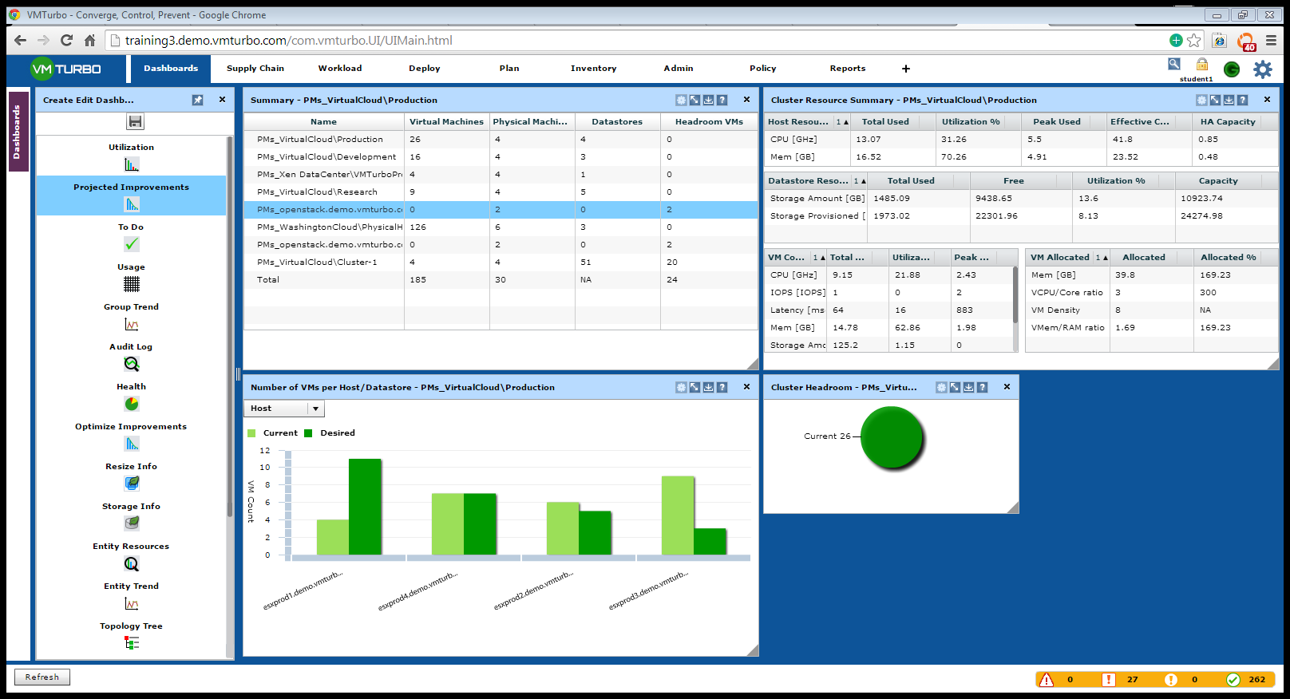
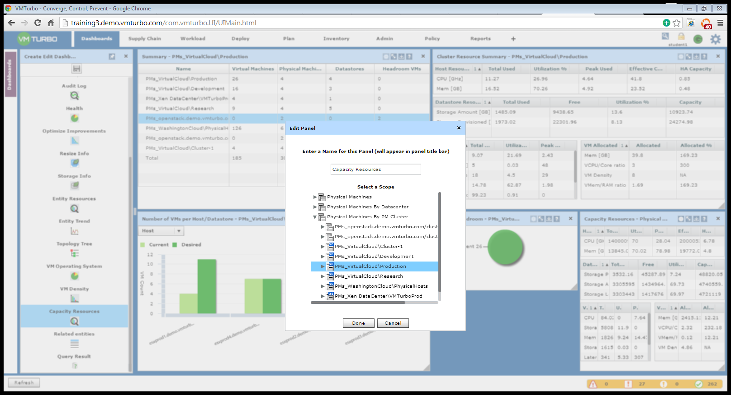
Custom Dashboards how to edit the standard views
Select the panel you want to add to the dash board
Drag the panel to an open spot
Once you drag the chart to the spot, it will prompt you to pick the cluster you want to add, then hit Done!
Click the save button and name it, this dashboard will be saved in my dashboard folder.
You can then generate to PDF/EXCEL, or Save it.
1
2
3

Slide 37
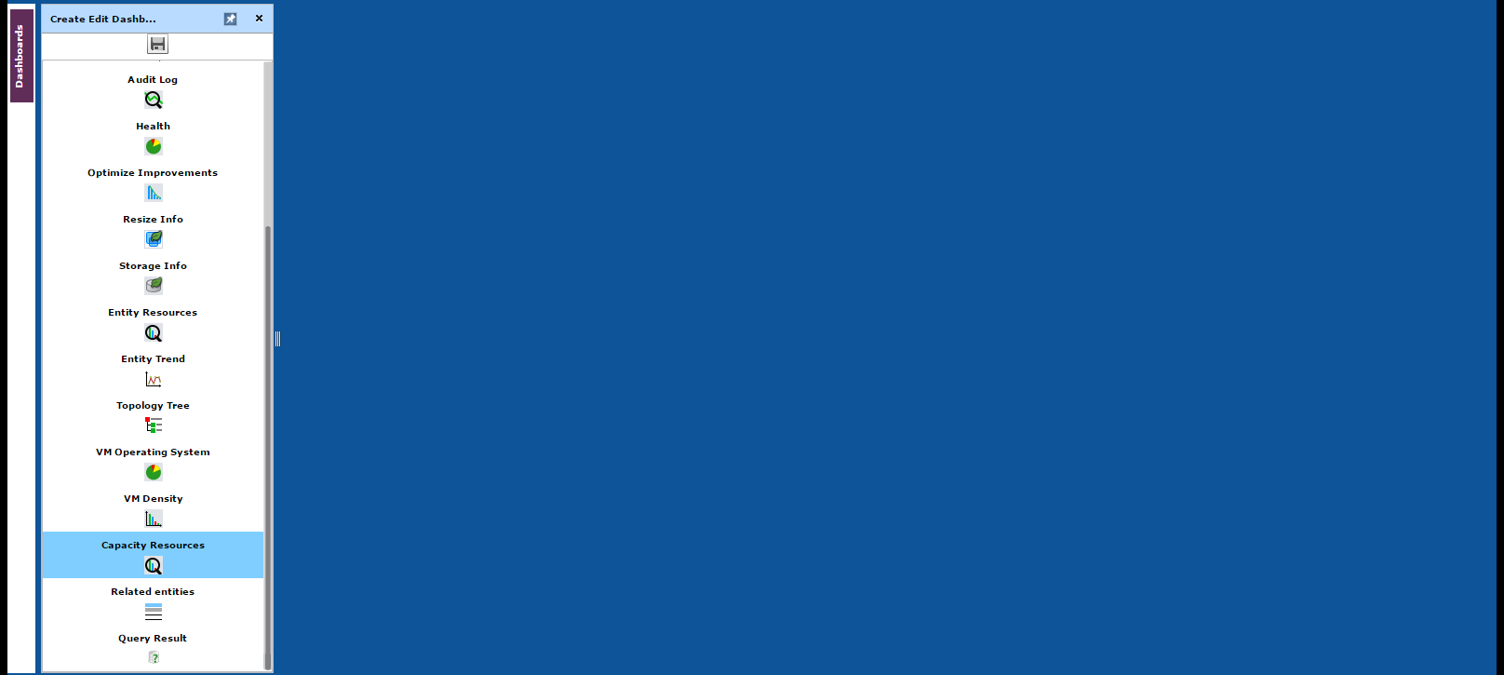
Custom Dashboards Creating a dashboard from scratch
1. Click this button
2. You will then see this screen.
3. Drag the view over to the blue area
4. Select the entity that you want to present
5. Repeat until you have the view you want
6. You can move panels and size them by clicking and dragging.
7. Click the save button.

Slide 38
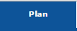
Advanced Planning how to use VMTurbo to plan for changes
About VMTurbo Planning:
VMTurbo’s planner solves the exact same problem the real time engine solves. The difference is the end user can change any level of the infrastructure, then have VMTurbo run its engine. VMTurbo will show you the current state of the cluster(s), and how the changes you made will impact the environment before actually doing it.
This takes the guess work out of determining how much supply (host, storage, resources, etc) you will need to run the demand of the VM’s (existing, changed, or added in the planner).
2. You will then see this screen.
3. Drag the view over to the blue area
4. Select the entity that you want to present
5. Repeat until you have the view you want
6. You can move panels and size them by clicking and dragging.
7. Click the save button.

Slide 39
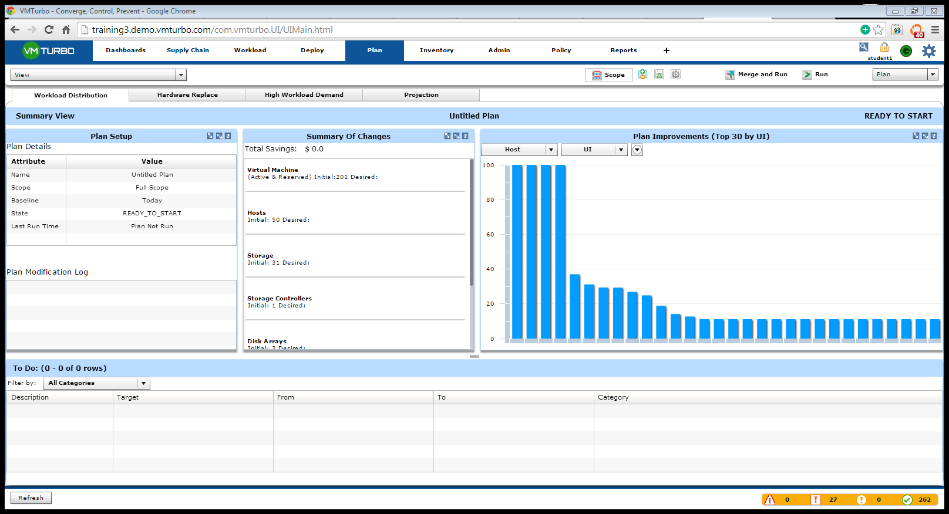
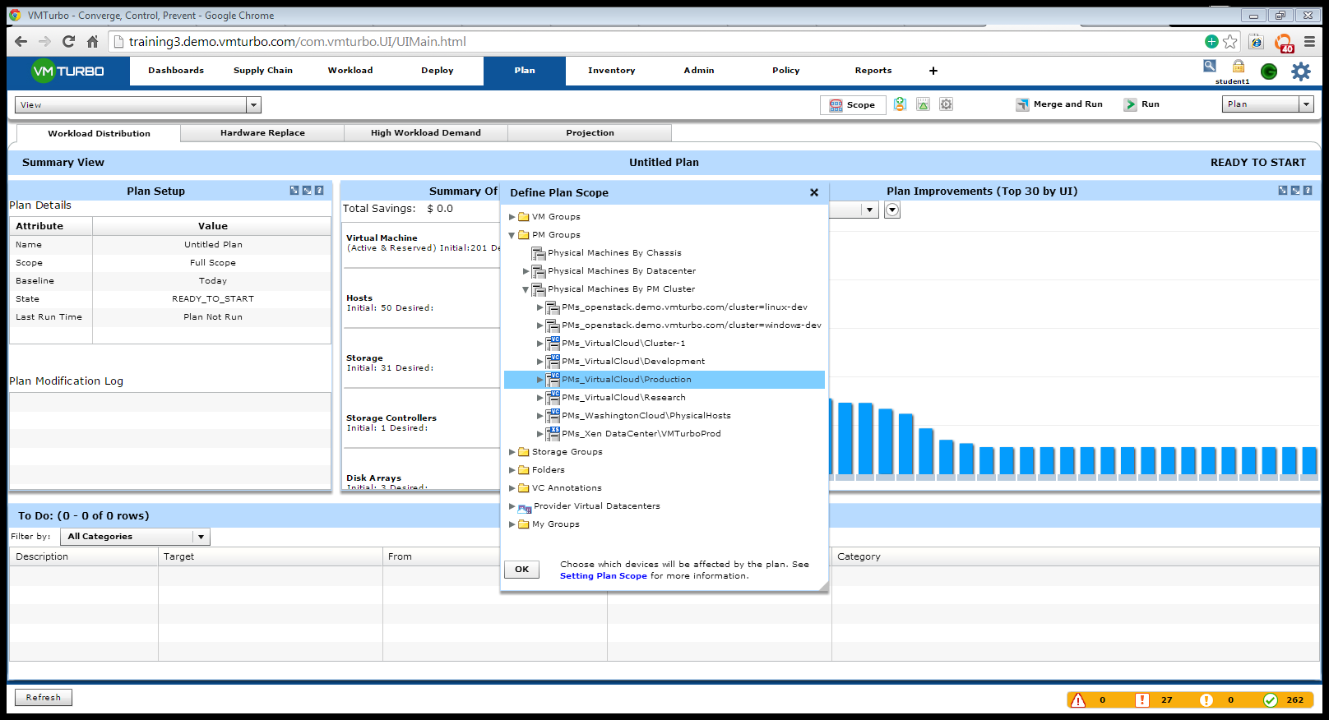
Advanced Planning how to use VMTurbo to plan for changes
Click the “Scope” Button. This will allow you to pick a cluster that you want to run plans off of. You can select multiple clusters here as well by holding the shift button down.
Select PM groups (PM stands for Physical Machines), then drop down to “Physical Machines by PM Cluster” – this will show all clusters.
Select the cluster you want to work with then hit OK.
1.
2. You will then see this screen.
3. Drag the view over to the blue area
4. Select the entity that you want to present
5. Repeat until you have the view you want
6. You can move panels and size them by clicking and dragging.
7. Click the save button.
2.
3.

Slide 40
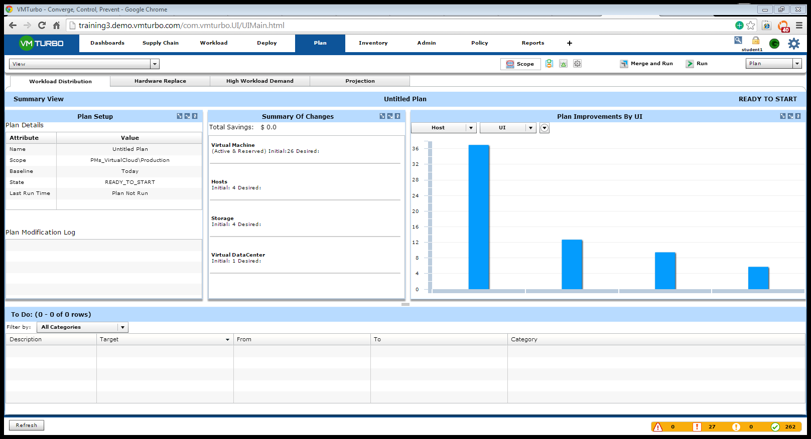
Advanced Planning how to use VMTurbo to plan for changes
3.
Once you hit ok on for the scope you will see the cluster name appear in the plan setup
You will get the current status of the cluster (VM, Host, Stroage, etc)
Now to change any level of the cluster click the +- button
1.
2. You will then see this screen.
3. Drag the view over to the blue area
4. Select the entity that you want to present
5. Repeat until you have the view you want
6. You can move panels and size them by clicking and dragging.
7. Click the save button.
2.

Slide 41
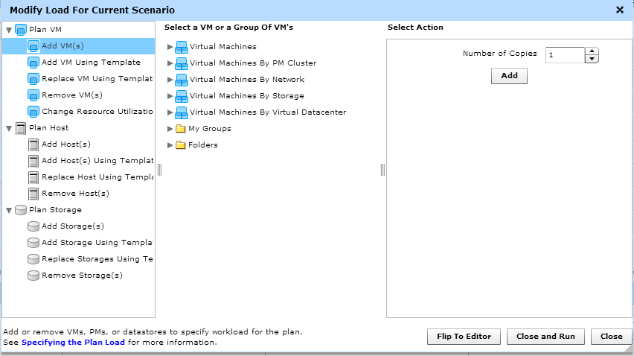
Advanced Planning how to use VMTurbo to plan for changes
You can select Plan VM, Host, Storage
Once you click on an entity, you can then select from the list of existing entities, or create your own (example: vm template, host template, storage templaye)
Select the number of copies you want to add
Click close and run
NOTE: if you click flip to editor you can take hosts, VMS, storage and simulate moving them into this cluster that you originally scoped down to.
3.
1.
2.
4.
Note

Slide 42
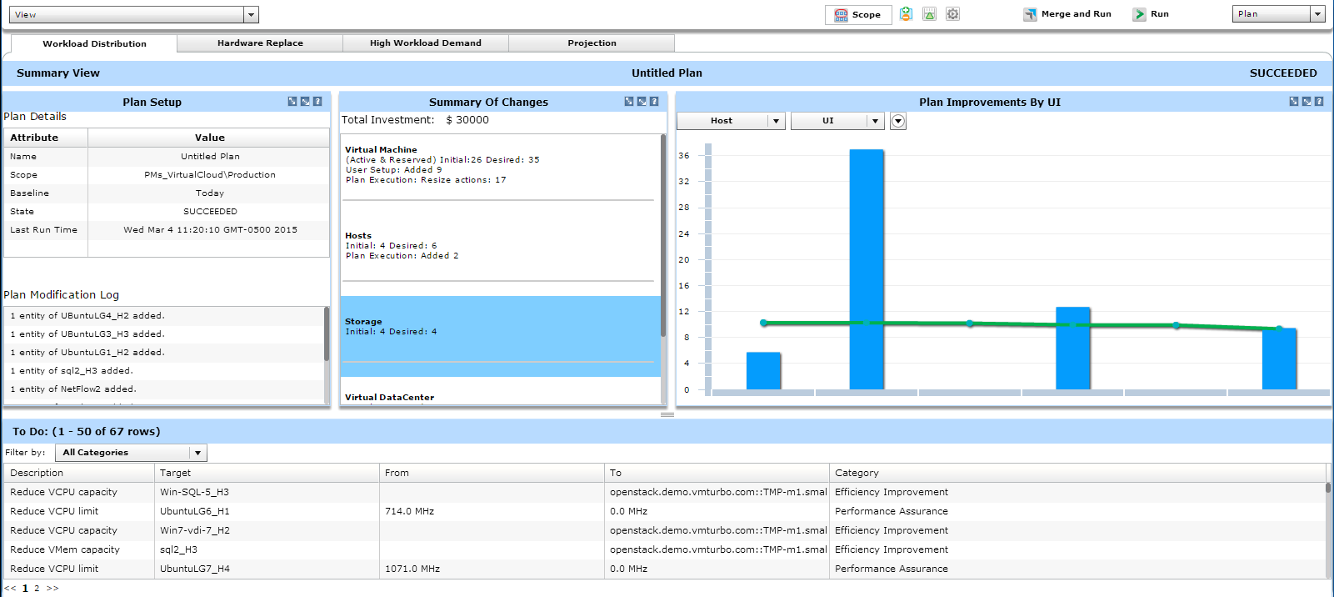
Advanced Planning how to use VMTurbo to plan for changes
Once plan is complete, you will see the changes here
Summary of changes (what we did)
Blue bars represent current utilization, green line represents how utilization would change. In this case VMTurbo recommended adding 2 hosts to this cluster based on the number of VMs we added.
Shows the placement and sizing decisions of the plan (just like the dashboard screen shows)
3.
2.
1.
4.

Slide 43
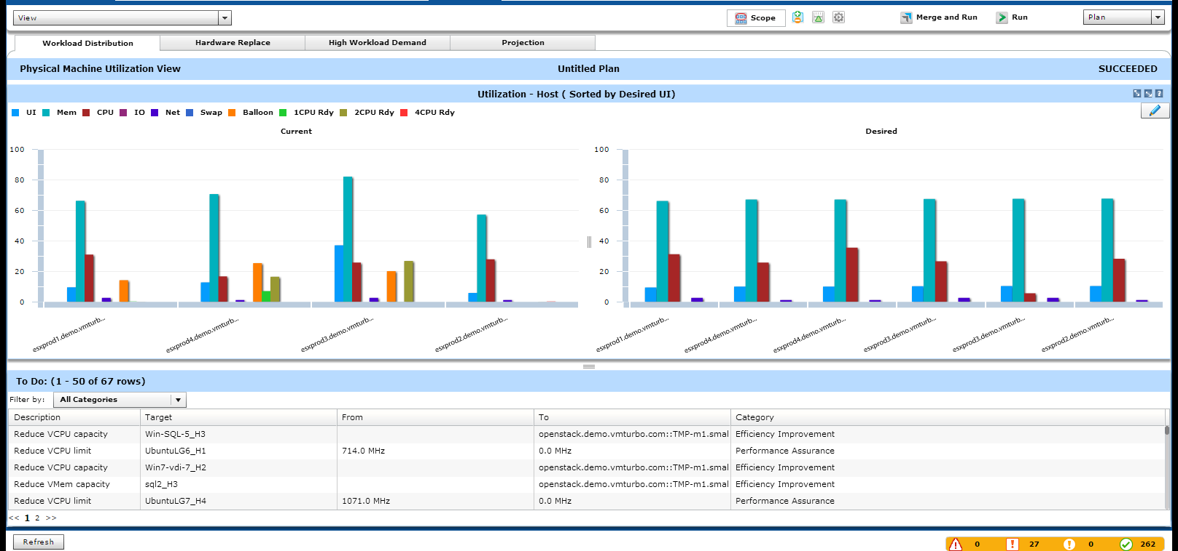
Advanced Planning how to use VMTurbo to plan for changes
If you click the view button and toggle to “Physical Machine utilization” you will see this view.
This is the current state of the cluster prior to changing it
This is where VMTurbo would bring the cluster to (adding the VMs)
Note the VMTurbo determined to add 2 additional hosts to support the VM growth
Placement, sizing, and capacity decisions
You can click here to save this plan (which you can then load at anytime), or even print out a report of all the details
5.
1.
3.
2.
4.

Slide 44
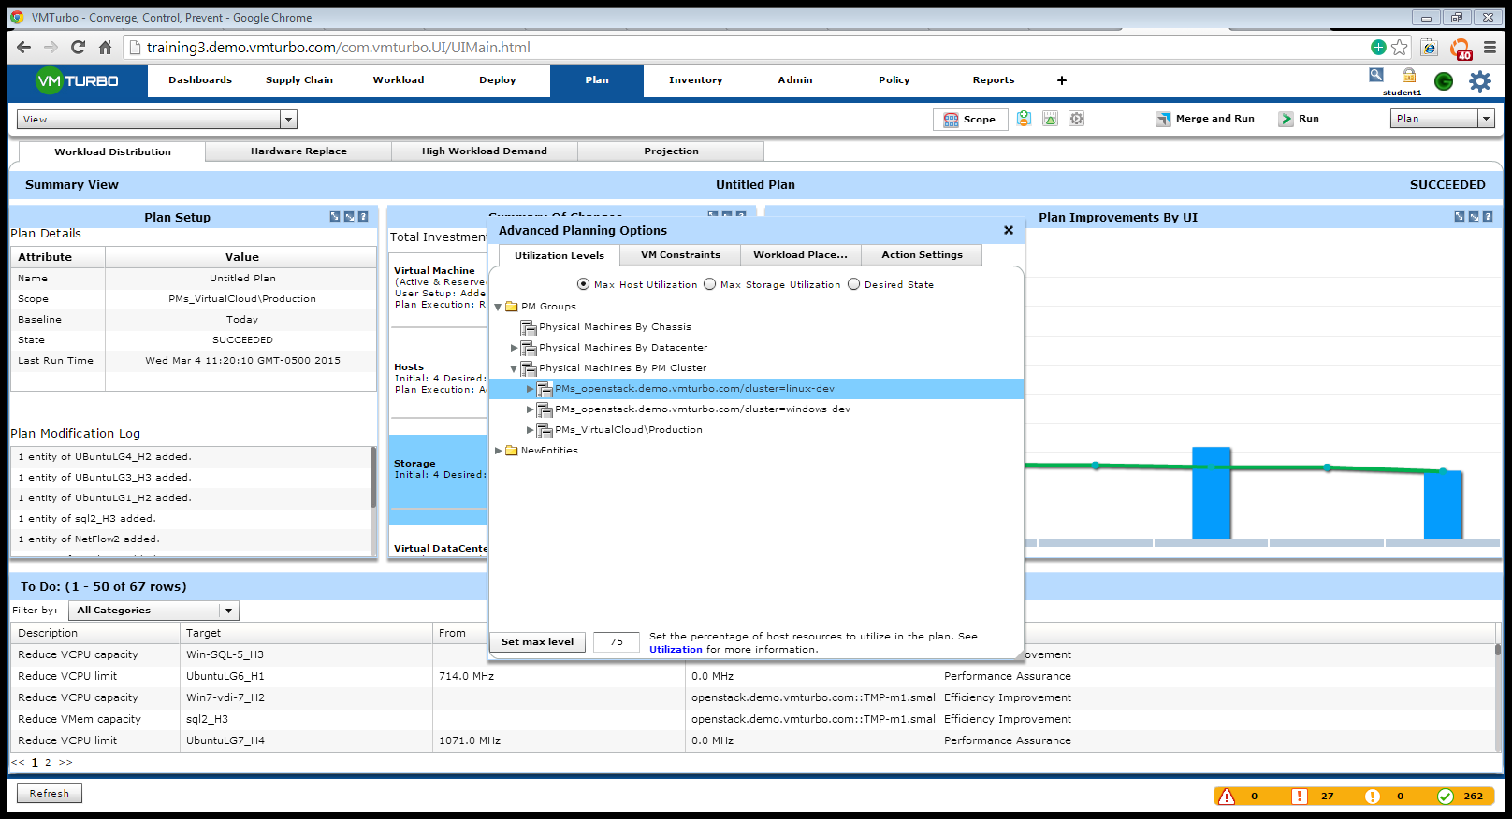
Planning Settings how to use VMTurbo to plan for changes
1.
This is the advanced settings tab, in this view you have 4 tabs:
Utilization levels: you can tell VMTurbo what you want the max utilization to be across hosts or storage
VM constraints: do you want VMTurbo to take your placement policies into consideration or not?
Workload placement: We import them from vCENTER directly and can simulate what would happen if we ignored them or enabled them
Action settings: do you want VMTurbo to allow or disable the following:
Host/datastore provision or suspension
Allow resize or not

